Slide 1
New Representative training

Slide 2
Your Why/ Ways to promote your Avon Business
1. Why did you join Avon?
2. What are some ways that you are going to Promote your Avon business?? Share different ways 100 No’s, events free and paid, posting/sharing every day(hashtags), 3 videos a week, lives in your customer group, facebook and face to face parties, advertising, fundraisers etc
3. Write a list of potential customers with their first names and go through that list to see how many would like to make some extra income. You will or I will help you contact these interested parties

Slide 3
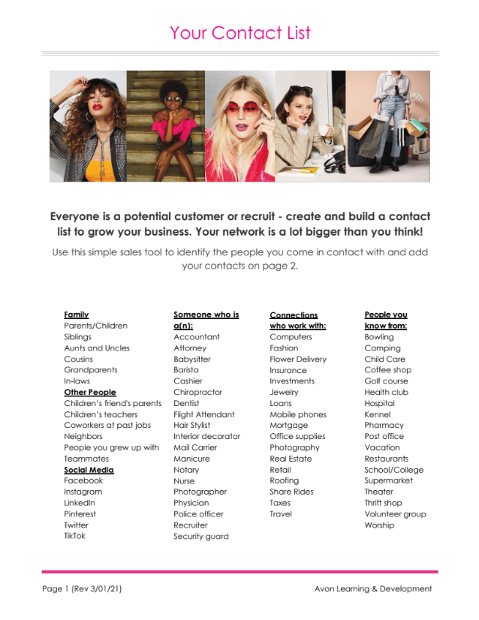
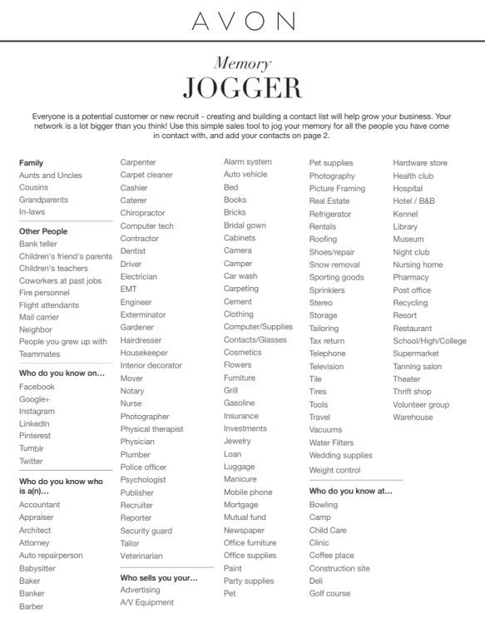
Customer List

Slide 4
Log in/Profile
1. Log into avon.com with your account number/email
2. You may have re log in if you use another device or Avon will call your number registered by Avon and you will press the # sign on your phone
3. Go to Hi(your name) and fill out the profile choose your links, answer all questions especially yes to letting a customer/recruit find me. Link your facebook, Instagram, twitter, pinterest. You can learn how to set them up by going to manage business Avon U
4. Go to manage business and go to the invoice personalization tool and fill out all information to set up your invoices.
5. Go to the Promotional tool and set up a promotion to send to your customers

Slide 5
Collecting up front with a face to face order
1. Get all contact information name, address, email and phone number
2. Write the campaign you are presently in. You can sell one campaign backwards
3 Write the page number product ID number, full description of product and the cost in that current brochure.
4. Add the total of the items
5. Add the processing fee which will help cover your One Simple Fee($7=$18 depending on the size of the order
6. Times the Subtotal + processing fee with your current cities tax percentage.
7. Add the Subtotal + processing fee + tax and that is what you would charge customer
8. Collect with cash or form of credit card swipers(square, paypal etc) or apps

Slide 6
Two sites to sell Avon in one
1. Your estore where you can share from MYSTORE which customers can get free shipping with a $60 order. Your customers sign in here
2. Face to face sales where you log in to avon.com or with your avon account/email number or saved password You sign in here
Questions
1. What could you do with $400-$2000 a week??

Slide 7
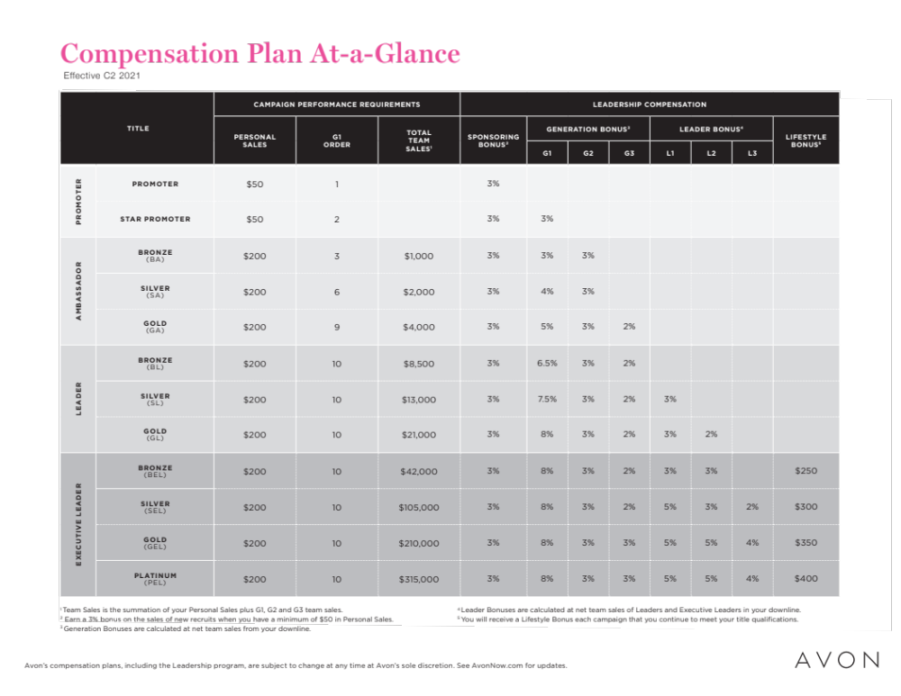
Earnings

Slide 8
To Pay Avon
1. When checking out by the grocery cart on the right you can use 2 ways with your
*credit card and *paypal. You can only make one payment before your order.
2. You need to register your bank card or you can use paypal and venmo.
3. You can check your balance by going to Manage business and balance to the left
4. Face to face sales payment is upfront so that you can pay your Avon bill when placing your order. I only accept cash if it is less than a $100 or use a square card reader which you can go to square.com to enroll and order a reader.

Slide 9
Getting earnings in your Bank account
1. Go to Manage Right upper corner
2. Go to Avon Wallet and read instruction and enroll
3. You will need your account #, bank account # and bank routing number and social security number
4. Once you place an order this will qualify you for this program and you will get funds deposited in your bank account for online sales and leadership earnings.

Slide 10
Resources to use/Manage business Tab
1. Like the Avon North Amercia page where it shares all kinds of sources for you to use, live webinars and workshops, announcements etc
2. Right next to it is Avon Youtube where you can find any resource, replay, available workshops and webinars and printables and much more.
3. Digital catalogue with awesome tools such as the try it on tool, videos
4. Perks with many resources such as Avery, Vistaprint corporate solutions plus many other great discounts and deals you can use.
5. Three resources I use are vistaprint.com(cardsetc) campaignmailer.net(mailing out brochures) square.com (credit card processor) etsy(bags, shirts etc) krash kreations(car decals. Zazzle ( cards, shirts, bumper stickers, buttons etc)
6. Dollar tree, Dollar general, etc to make baskets, office supplies etc
7. If you need anything I have lots of resources

Slide 11
Three ways to place an order
1. Shop menu and choose from the categories including sales tools( books bags)
2. Shop by product, which you would enter the ID or product name, select the campaign and price. You would first enter the customers name, address, phone number and email before adding items to the product list.
3 You can also shop the Featured items menu and shop the special buys(clearance and special bundle deals)
3. The other way is to use the digital catalogue menu where you can click on the current or previous brochure and shop by section or click on content to the left.
4. You can also shop your current digital catalogue/good buys/what’s new which has the books front and center and on the left it has some of the other brochures you can access

Slide 12
Checkout
1. You would checkout with the grocery cart to the upper right. Click on it and it will take you to a menu
2. Once you have checked all the items you will choose your ground shipping and use any credit available. Also be sure to check your emails to see if Avon has sent you any promotional codes to use such as free shipping, gifts etc
3. Submit your order and make sure you see a confirmation email regarding your order.
5. Once order is submitted you can go to Manage business and order history and order ID to check the status of your order.
6. You can find your order, your customer orders or any other online orders by the manage business tab and order history. You can click the ID to check order information and customer information

